Slide 1


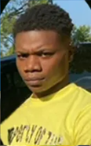
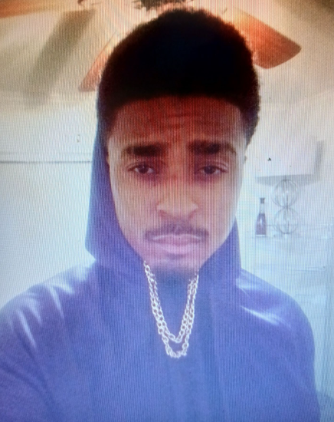
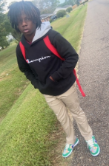

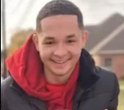
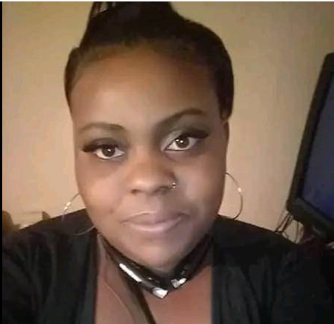
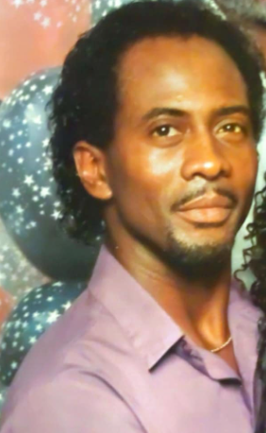
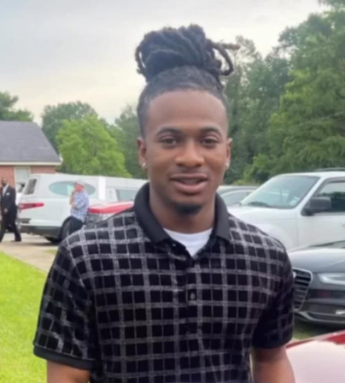
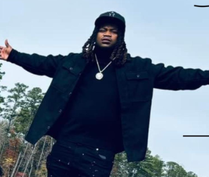
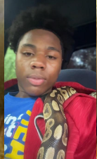
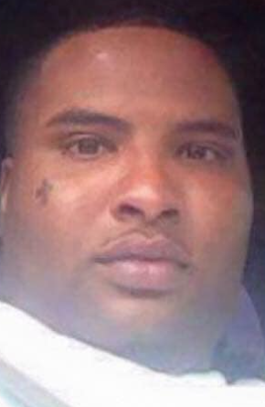
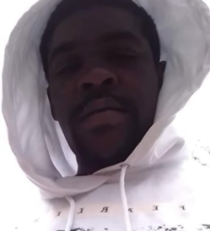
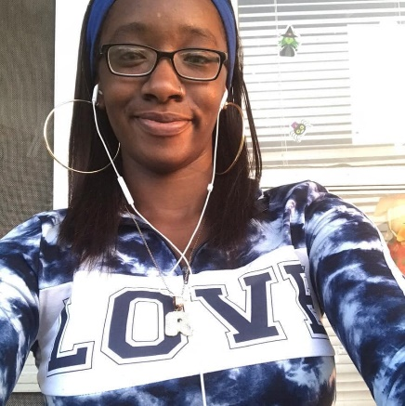
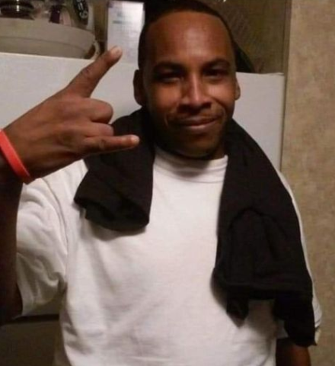
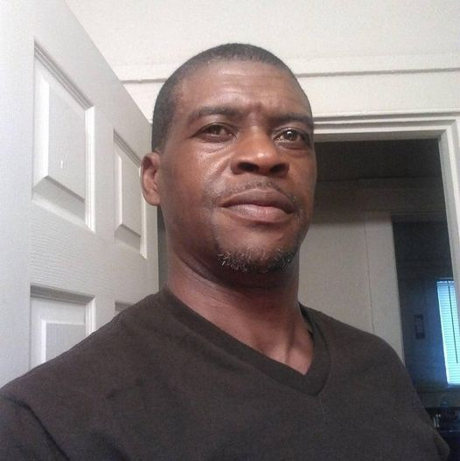
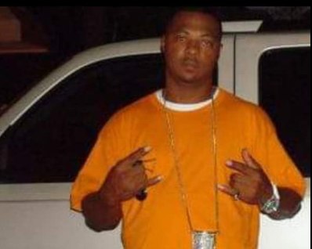
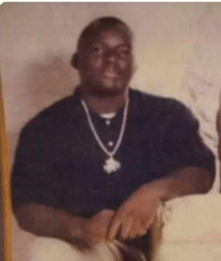
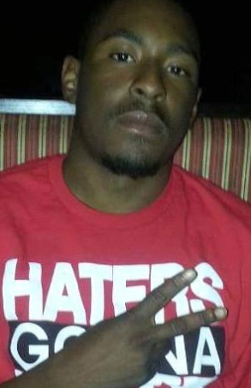
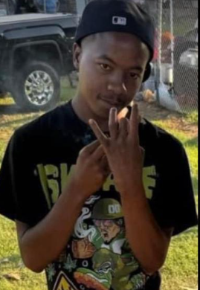
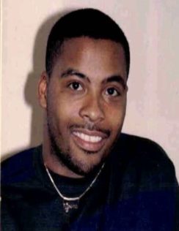
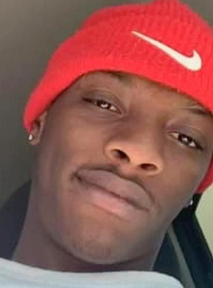
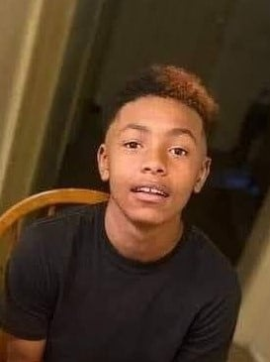
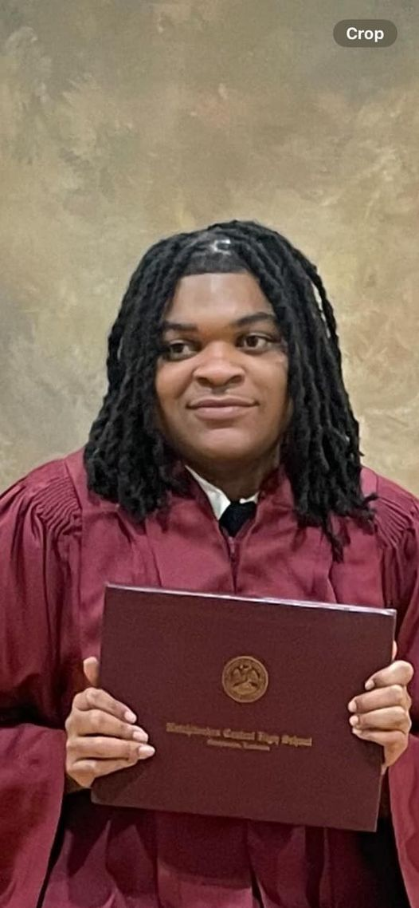
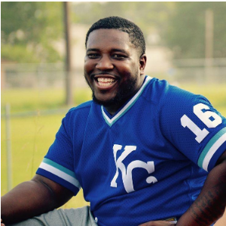
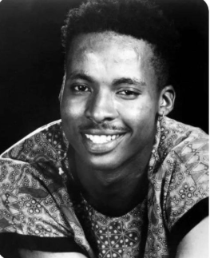
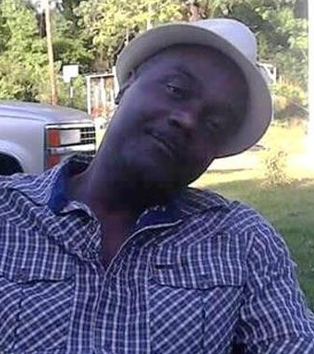
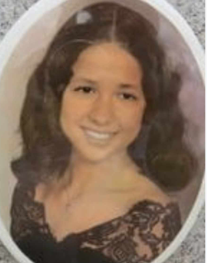
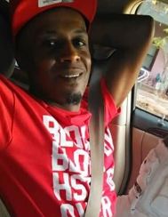
UNSOLVED CASES
Natchitoches

Slide 2

Unsolved Murders of Natchitoches: Growing Cases and a Call for Community Action
Latorria Freeman, Publisher
This article was originally published on August 30, 2024, and has been updated to include additional unsolved cases in Natchitoches. Unfortunately, the list of cases has risen to 36. We strongly encourage the community to get involved.
If you have any information, please do not hesitate to contact the Natchitoches City Police at (318)352-8101, the NPSO Criminal Investigations Division at (318)357-7830, or Natchitoches Crime Stoppers at (318)238-2388. You can also visit their website at https://natchitochescrimestoppers.com/.
You could be eligible to receive a cash reward ranging from $250 to $2,000.

Slide 3
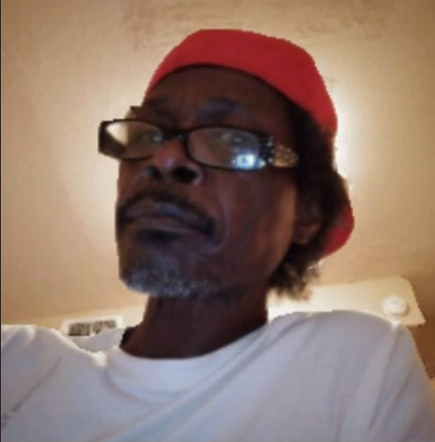

Natchitoches City Police (318)352-8101 NPSO Criminal Investigations Division (318)357-7830 Natchitoches Crime Stoppers (318)238-2388
D’Mario Moran, age 33 Murdered October 27, 2024
Devin Prudhomme, age 16, Death September 26, 2024
Quenton Nash, age 32 Fatal Hit & Run September 4,2024
Kadarius “KD” Miller, age 24 Murdered September 1, 2024
Cameron Dwon Jackson, Age 19, Murdered March 2, 2024
Deon Shontell Coleman Jr., age 23, Murdered March 17, 2024
Daylon Harris, age 15, Murdered April 29,2024
Jourdan Taylor, 16, Murdered July 3, 2024
Johnny Ray Simmons, age 70, Victim of a Hit and Run on July 30, 2024
Derrick Tatum, age 19 Shot on October 1, 2020, Died from Injuries June 13, 2023
Marcus Sowell, age 23, Murdered December 26, 2023
Daniel Williams, age 23 Murdered on June 25, 2022
Notes:
Sort cases from new cases to old cases

Slide 4
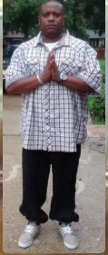

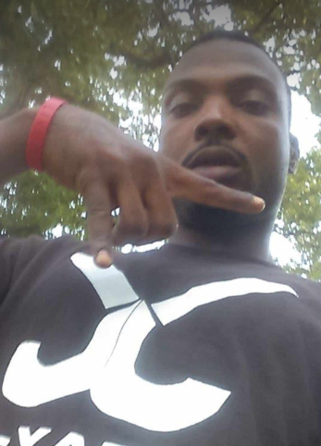
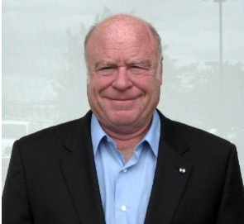
Natchitoches City Police (318)352-8101 NPSO Criminal Investigations Division (318)357-7830 Natchitoches Crime Stoppers (318)238-2388
Renrick Duke, age 38, Murdered January 31, 2022
Kimanesha Nicole Carter, age 28, Murdered March 17, 2022
Rodjay Jaheim Stackhouse, age 19 Murdered November 26, 2022
Brandon McHenry, age 23 Murdered January 13, 2021
Kandra Randolph, age 28, Murdered January 28, 2021
Jay Tousant Jr., age 21, Murdered August 6, 2022
Jerome Pier, age 38, Murdered April 11, 2021
Paul Smith Jr., age 14, Murdered November 27, 2021
Thomas Payton, age 52. Body found December 17, 2021
William R. “Bob” Lang Jr. age 76, Murdered December 29, 2021
Eddie Varice Jr., age 34, Murdered May 31, 2020
K'yia Monique Pier, age 19, Body Found May 16, 2018
Notes:
Sort cases from new cases to old cases

Slide 5
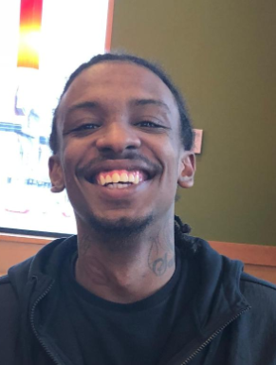
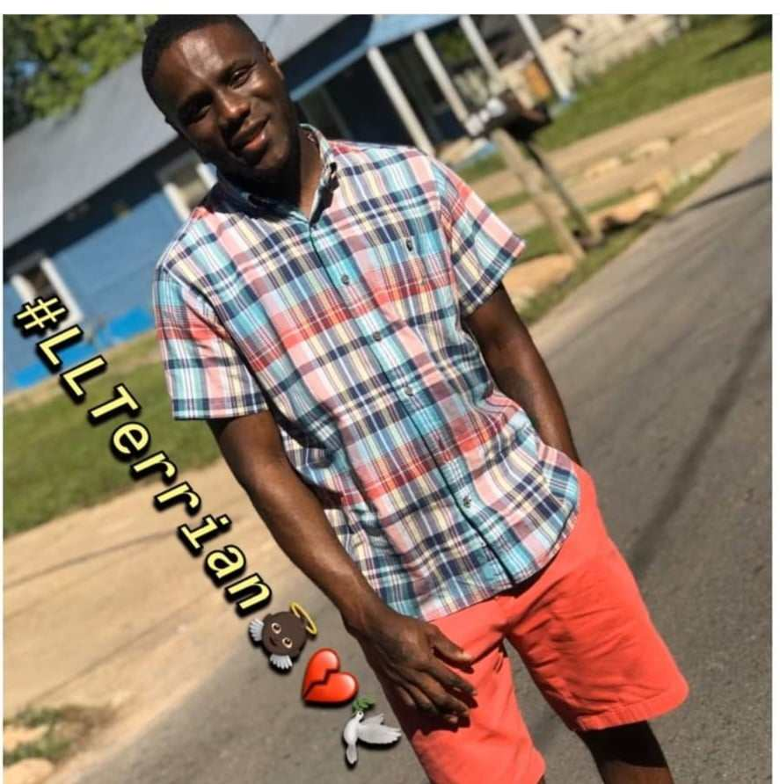
Natchitoches City Police (318)352-8101 NPSO Criminal Investigations Division (318)357-7830 Natchitoches Crime Stoppers (318)238-2388
Cordarious Cortez Smith, Age 24, Murdered August 8, 2018
Rodney D. Richards, age 24, Murdered August 8, 2018
Ronald Gary Green, 57 Murdered on December 11, 2018
La’Terrian Mitchell, age 27, Murdered December 17, 2019
Prysock Freeman, age 48 Murdered July 23, 2017
Stafford Jefferson, age 52. Murdered September 22, 2017
Frederick Sowell, age 35, Murdered November 21, 2015
Trevor Bush, age 25, Murdered December 7, 2015
Kenneth “Dogg” Bayonne, Age 32, Murdered August 18, 2011
Lee Otis Payne Jr., age 26, Murdered January 17, 2010
Tyrone Turner, age 24, Murdered May 20, 1994
Rosalind Meziere, age 26, Body found September 15,1988
Notes:
Sort cases from new cases to old cases

Slide 6

UNSOLVED CASES IN NATCHITOCHES
If you have any information, please do not hesitate to contact the Natchitoches City Police at (318)352-8101, the NPSO Criminal Investigations Division at (318)357-7830, or Natchitoches Crime Stoppers at (318)238-2388.
You can also visit their website at https://natchitochescrimestoppers.com/.
You could be eligible to receive a cash reward ranging from $250 to $2,000.

